Slide 1
Streams
Shristi Technology Labs

Slide 2
Contents
Streams
Intermediate Operations
Terminal Operations

Slide 3
Streams
A Stream represents a sequence of elements and supports parallel and aggregate operations.
Streams are abstraction for processing collections of values.
Streams can be created from collections, arrays, or iterators.
Streams allows to transform and retrieve data
A stream does not store its elements
Stream operations don’t change their source
Returns new stream holding the result.
Have Specialized Streams for primitive data types

Slide 4
Creation of Streams
To convert a collection to stream, use stream() from Collection
To convert an Array to a stream, use the static Stream.of
To make a stream from a part of the array, use Arrays.stream(array, from, to)
To make a stream with no elements, use static Stream.empty()
To make a stream with infinite elements, use static Stream.generate()

Slide 5
Types of Streams
stream()
Returns a sequential stream with collection as its source.
parallelStream()
Returns a parallel Stream with collection as its source.
Convert streams into parallel stream to do filtering and counting in parallel
Streams can hold different data types
Stream<String[]>
Stream<Set<String>>
Stream<List<String>>
Stream<List<Object>>
Stream<Integer>

Slide 6
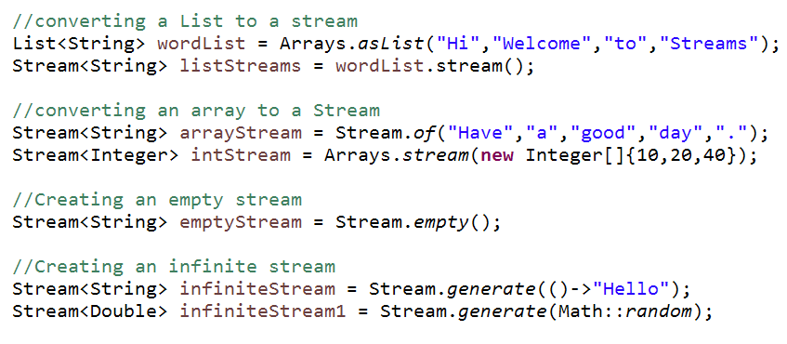
Example

Slide 7
Operations on Streams
Stream operations are divided into
Intermediate operations – returns a new stream
Terminal operation – returns a result
Operations are combined to form stream pipelines.
A stream pipeline consists of a source (such as a Collection, an array, a generator function) followed by zero or more intermediate operations and ending with a terminal operation
Stream operations do the iterations internally over the source elements provided.

Slide 8
Intermediate operations
Intermediate operations always return a new stream.
eg. filter(), map(), limit(), skip(), distinct(), sorted()
Also called as lazy operations
Multiple intermediate operations can be chained together
The intermediate operation will NOT begin until the terminal operation of the pipeline is called.

Slide 9
Terminal operation
The terminal operation traverses through the stream to produce a result.
Also called as early operations
After the terminal operation is performed, the stream pipeline is considered consumed, and can no longer be used
eg. iterator(), reduce(), forEach(), findFirst(), match(), collect(), count()

Slide 10
Pipeline of operations
Create a stream.
Specify intermediate operations for transforming the initial stream into another stream
Apply a terminal operation to produce a result.
Next, the stream can no longer be used.

Slide 11
Intermediate Operation

Slide 12
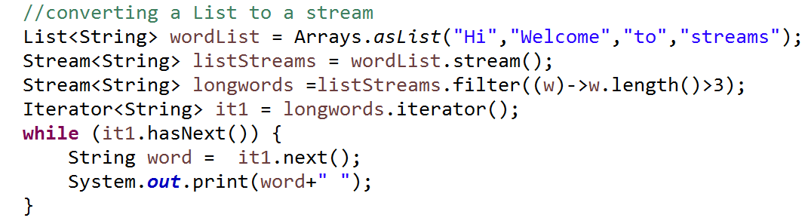
Stream Operations - filter
filter
reads data from a stream and yields a new stream with all elements that match a certain condition.
Is an intermediate operation Stream<T> filter(Predicate<T> predicate )
Output: Welcome streams

Slide 13

Stream Operations - filter
Using method chaining
Output: Welcome streams

Slide 14
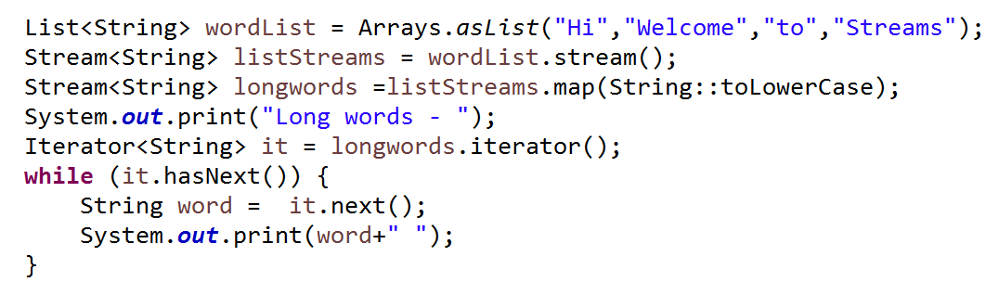
Stream Operations - map
map
to transform the values in a stream as lowercase, uppercase, getting characters. etc
Is an intermediate operation Stream<T > map(Function <T> val)
Output: welcome streams

Slide 15
Stream Operations - flatMap
flatMap
to transform the values in a stream as lowercase, uppercase, getting characters etc.
used when the stream is of type List, Set or Array like String<List<String>>
Is an intermediate operation Stream<T> flatMap(Function <T>)
Stream<String[]> -> flatMap -> Stream<String>
Stream<Set<String>> -> flatMap -> Stream<String>
Stream<List<String>> -> flatMap -> Stream<String>
Stream<List<Object>> -> flatMap -> Stream<Object>

Slide 16
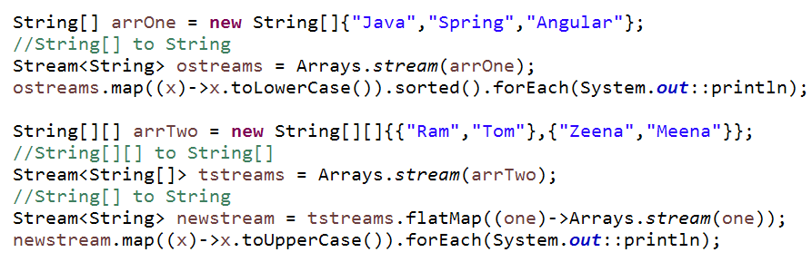
Example – map & flatMap
Output:
java
spring
angular
Output:
RAM
TOM
ZEENA
MEENA

Slide 17


Stream Operations – limit, skip
limit
to limit the number of elements to the size given Stream<T> limit(long size)
skip
to discard the first n elements Stream<T> skip(long n)

Slide 18
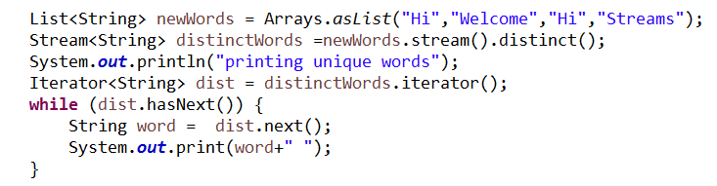
Stream Operations - distinct
distinct
Returns a stream consisting of the distinct elements. For ordered streams, the selection is stable (element appearing first will be preserved, in case of duplicate elements.)
For unordered streams, no stability guarantees are made
Stream<T> distinct()
Output: Hi Welcome Streams

Slide 19

Stream Operations - sorted
sorted
Returns a stream consisting of the elements, sorted according to natural order.
For ordered streams, the sorting is stable
For unordered streams, ClassCastException will be thrown when a terminal operation is called
Stream<T> sorted()
Output:
ANGULAR
EMBER
JAVA
JAVASCRIPT
NODE
SPRING

Slide 20
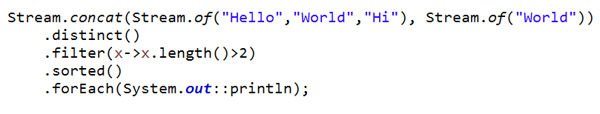
Stream Operations - concat
concat
Concatenate two streams using concat method.
For ordered streams, the selection is stable (element appearing first will be preserved, in case of duplicate elements.)
For unordered streams, no stability guarantees are made
Stream<T> concat(Stream a, Stream b)
Output: Hello World

Slide 21
Terminal Operation

Slide 22
Stream Operations - iterator
iterator
Is a terminal operation Iterator<T> iterator()
To iterate the elements in the stream
Output: welcome streams

Slide 23

Stream Operations - forEach
forEach
to iterate each element of the stream.
Is a terminal operation
void forEach(Consumer<>)
Output:
Hi
Hello
welcome

Slide 24
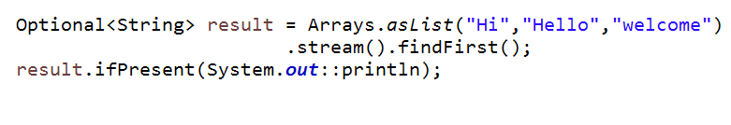
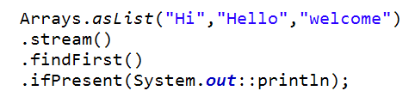
Stream Operations - findFirst
findFirst
finds the first element in a Stream.
returns an Optional instance which is empty if the Stream is empty:
Is a terminal operation
Optional<T> findFirst()
Output: Hi

Slide 25
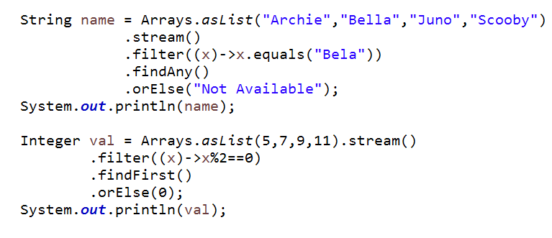
Stream Operations - orElse
orElse
Checks for value in Optional, if present returns that value, else returns the value passed in the argument.
Is a terminal operation
T orElse(T other)
Output:
Not Available
0

Slide 26
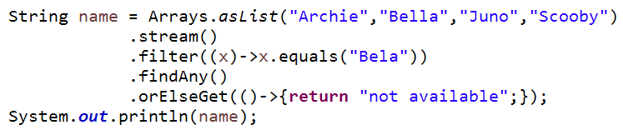
Stream Operations - orElseGet
orElseGet
Checks for value in Optional, if present returns that value, else returns the result of code inside the argument.
Is a terminal operation
orElseGet(Supplier<T> other)
Output: not available

Slide 27
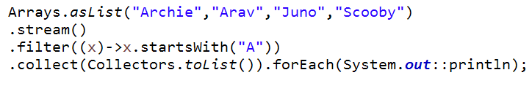
Stream Operations - collect
collect
The object resulting from intermediate operations will be collected
List<T> collect(Collectors List<Collector> collector)
Output:
Archie
Arav

Slide 28

Stream Operations - reduce
reduce with Accumulator
Allows to calculate result using all the elements in the stream.
Allows to perform arithmetic operations like sum, average and count on stream objects and get numbers as results.
Is a Terminal Operation
Optional<T> reduce(BinaryOperator accumulator)
Output: 60

Slide 29
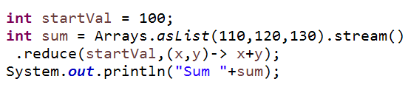
Stream Operations - reduce
reduce with identity & Accumulator
Allows to calculate result using all the elements in the stream.
Result will be identity + sum of array. .
Is a Terminal Operation
T reduce(T identity, BinaryOperator<T> accumulator)
Output: Sum 460

Slide 30
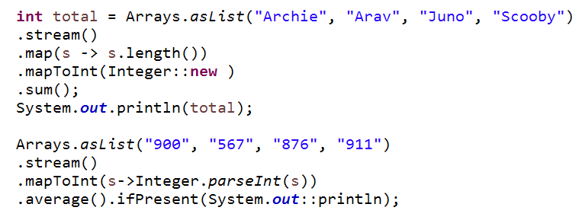
Stream Operations - mapToInt
mapToInt
Returns an IntStream with the results of applying the given function to the elements of this stream
IntStream mapToInt(ToIntFunction<? super T> mapper)
Output:
20
813.5
Output: Sum 460

Slide 31
Streams for primitives
Special streams for working with the primitive data types int, long and double.
IntStream
LongStream
DoubleStream
Uses specialized lambda expressions –
e.g. IntFunction , IntPredicate
Supports the terminal aggregate operations sum() and average()

Slide 32
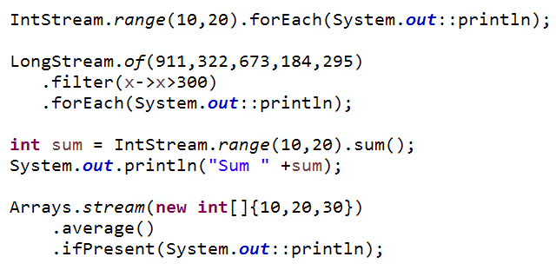
Example

Slide 33
Summary
Streams

Slide 34
Thank you

